Slide 1
Used Cars Price Analysis
Name: Elchuri Arun Kumar
Date: 03-10-204

Slide 2
Topics
Introduction
Web Scrapping to collect data
Data Cleaning and Manipulation
Visualization and Analysis
Conclusion.

Slide 3
INTRODUCTION
“ The main goal of this project is to analyze used car data and provide valuable insights to help clients better understand market trends and prices. This project covers price variations across different car brands, and we recommend the top 7 cars based on their quality. This analysis will help clients enhance their decision-making process by offering a clearer view of the data through charts. The data was web-scraped from a Cars 24 web - site. ”
Link : https://www.cars24.com/buy-used-cars-hyderabad/

Slide 4
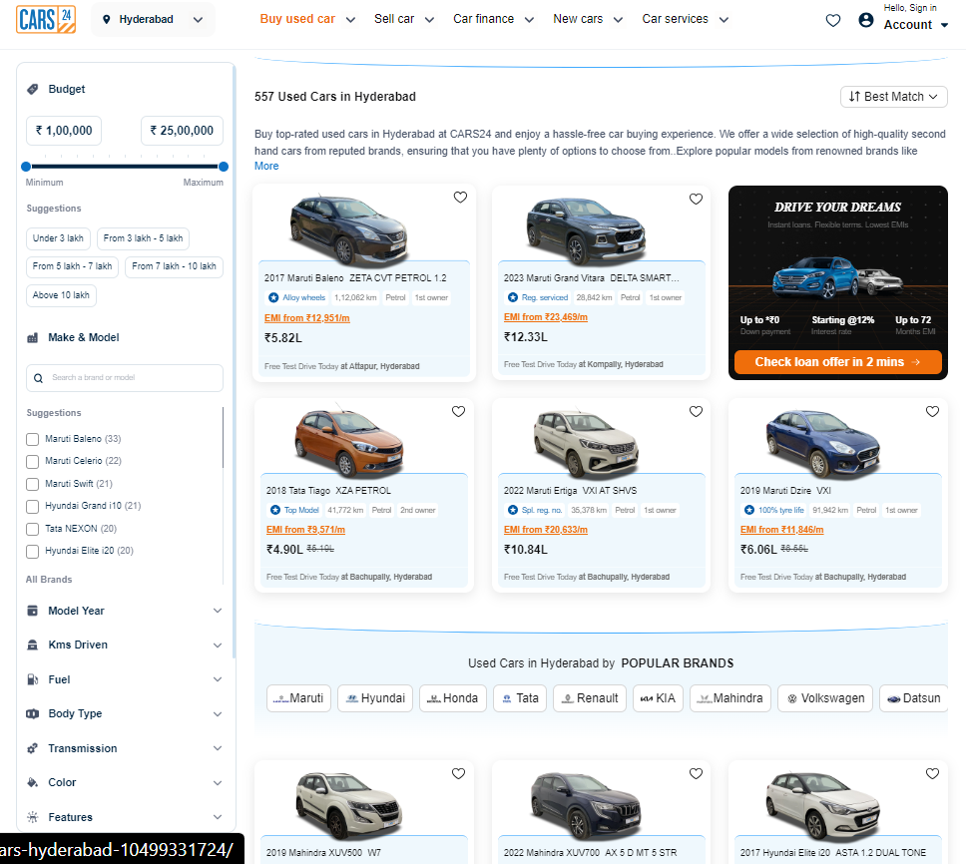
WEB-SCRAPING FOR DATA COLLECTION
We collect raw data from the Cars24 website, as shown in the image below.

Slide 5
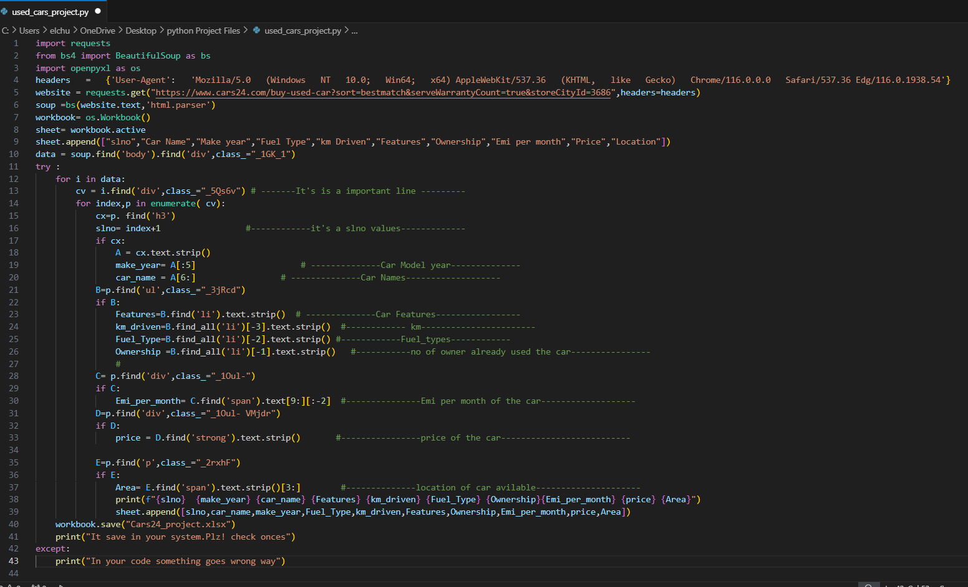
We write Python Web-scraping code to convert the website data into a useful dataset.

Slide 6
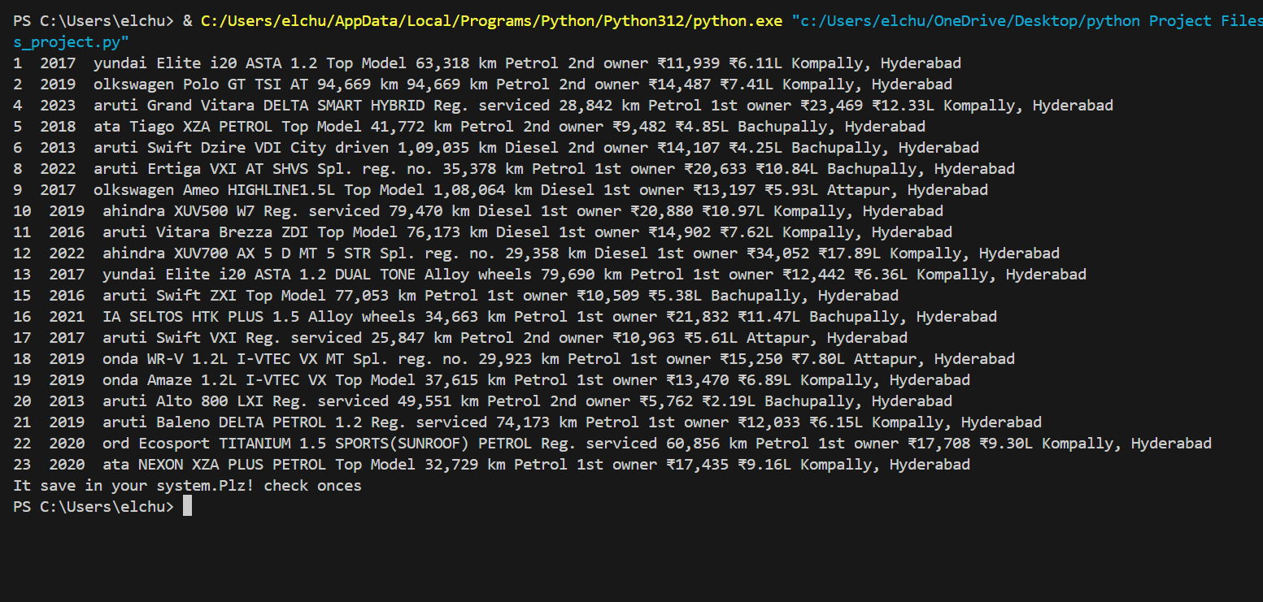
This the output above image python web-scraping code

Slide 7
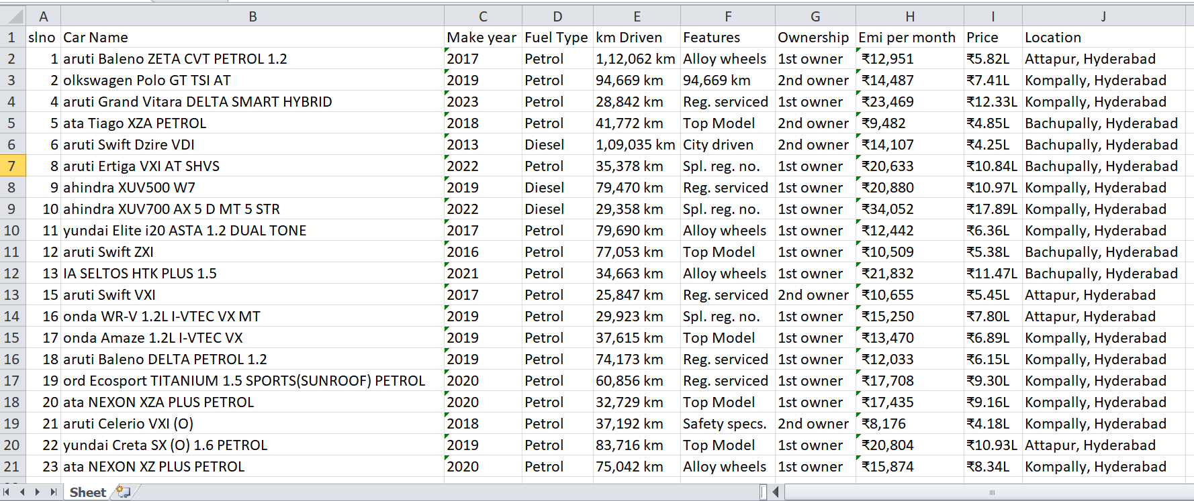
Data Cleaning and Manipulation
After collecting data from the webpage, we stored it in an Excel sheet. You can see the image below for reference.
Image 1:

Slide 8
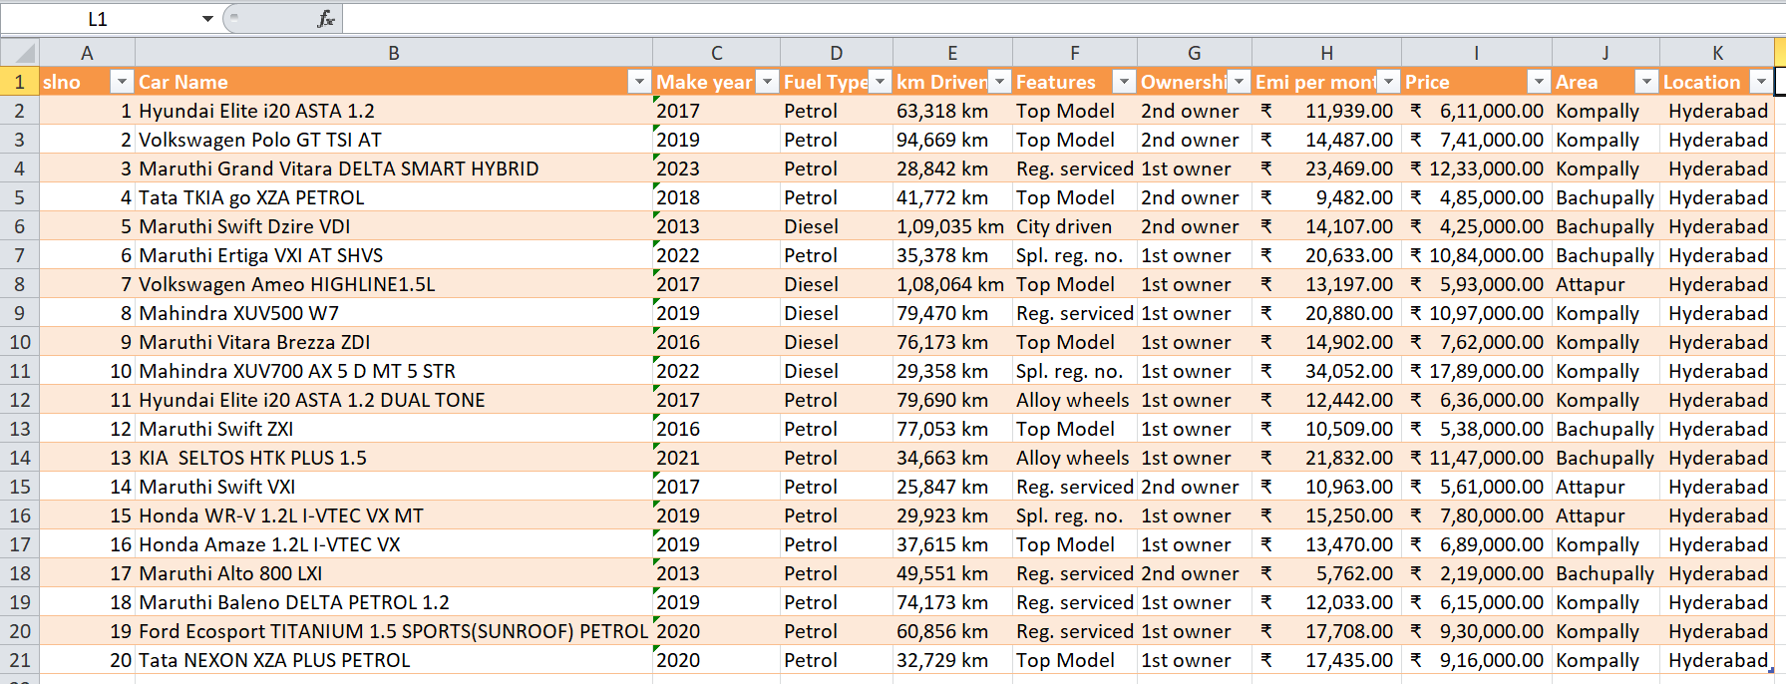
The image 1is unclear and difficult to understand, so we need to clean the data and correct any spelling errors. You can see that the image below is clearer and provides better clarity.
Image 2:

Slide 9
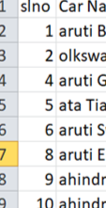
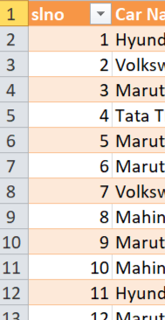
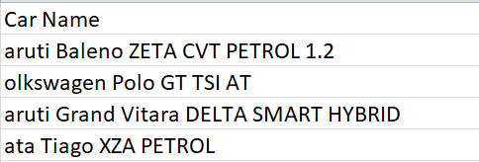
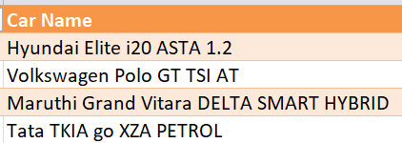
Data Cleaning & Manipulation process:
Data cleaning :
As seen in the above Image 1, the “slno column number are missing (3,7,etc)” . We corrected number sequence proper format like Image 2. you can see down fig. we rewrite number sequence
Before Data Cleaning After Data Cleaning
As seen in the above Image 1, “the car name column contains spelling errors.” We corrected these errors by converting the car names to their proper format like Image 2. we change the car name with a replace option into correct car names.
Before Data Cleaning After Data Cleaning

Slide 10
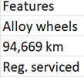
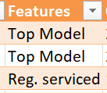
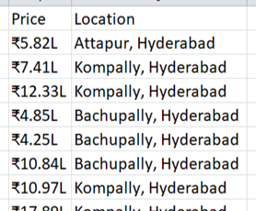
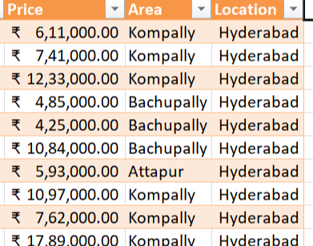
As seen in Image 1, “The second row of the features column contains incorrect data”. We corrected this and replaced it with the accurate information in Image2.
Before Data Cleaning After Data Cleaning
As seen in Image 1, “The price and location is unclear , A price in format of decimal and string and location is mix with area”. We convert the price into number Format and location is separated into two columns: area and location as you can see down below. For the price column, we use formula :
= VALUE(SUBSTITUTE([@Price],"L"," ")*100000)
Before Data Cleaning After Data Cleaning

Slide 11
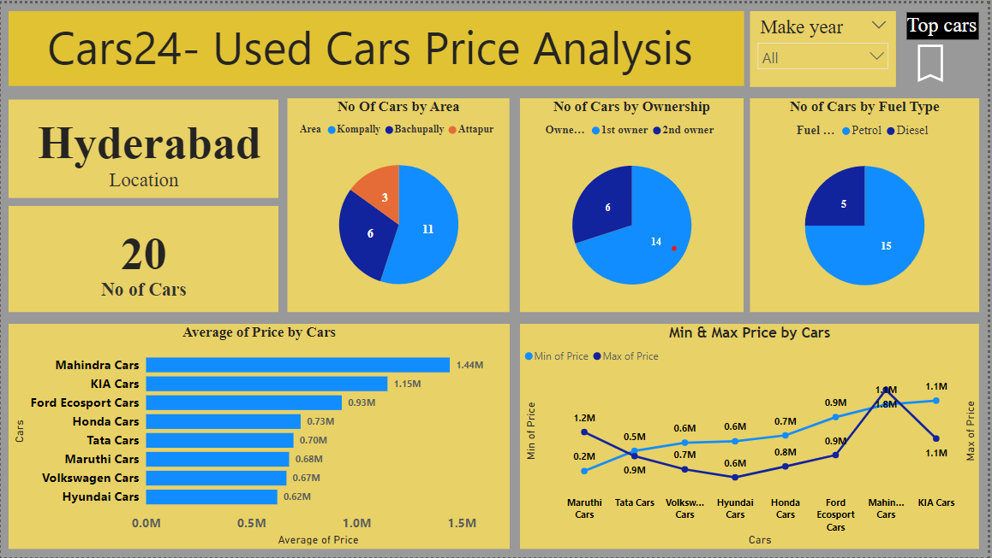
DATA VISUALIZATION AND ANALYSIS
After data cleaning and manipulation in Excel, we imported the data file into Power BI, a visualization tool. And we create a Two Report pages.
1st Report Page :

Slide 12
The title of report pages is "Used Cars Price Analysis." The first report page visualization explains the car price variation based on various car brands in the Hyderabad location, using data from the Cars24 website. It provides insights into car availability, ownership, fuel type, and price trends.
Location and Number of Cars: The analysis focuses on Hyderabad and displays a total of 20 cars available in the market.
Number of Cars by Area: The cars are distributed across three areas— Kompally (11 cars), Bachupally (6 cars), and Attapur (3 cars). And it display in pie chart.
Ownership: The 14 cars are first-owner vehicles, while the remaining 6 cars are second-owner vehicles. And the it is display in pie chart.
Fuel Type: The pie chart shows the fuel types of the cars, showing that there are 15 petrol cars and 5 diesel cars, with petrol cars being the predominant fuel type.
Average Price by Car Brands: The bar chart highlights the average prices for different brands. Mahindra cars have the highest average price is ₹1.44M, KIA is ₹1.15M and Ford Eco sport is ₹0.93M. Other brands like Honda, Tata, and Hyundai are priced lower on average.
Min & Max price by Car Brands: The line chart shows the minimum and maximum price ranges for various car brands. For example, Maruti cars have prices ranging from ₹0.2M to ₹1.2M, while Mahindra cars from ₹0.9M to ₹1.9M.
Additional Features: we allows in report page client also filter data by the year of car manufacture using the "Make Year" dropdown and explore the top cars through the "Top Cars" button.

Slide 13
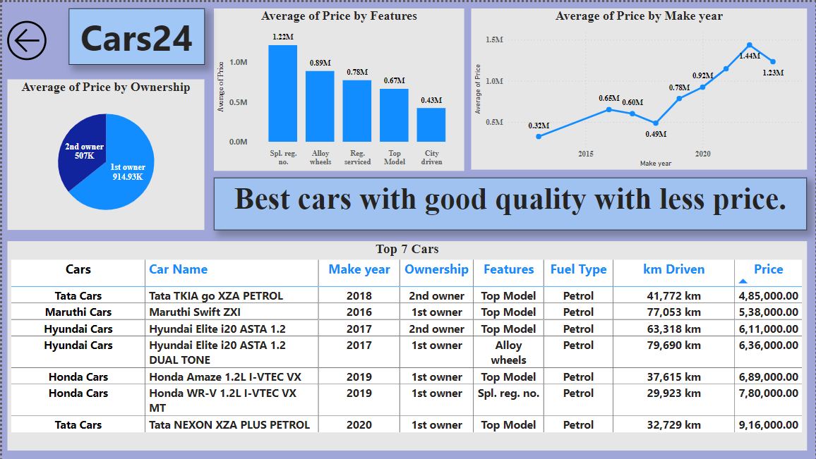
2nd Report Page :

Slide 14
The Cars24 2nd report page focuses on "Best cars with good quality at a lower price," providing insights into ownership, features, and manufacturing year.
Average Price by Ownership: In the report page we present in a pie chart shows that the average price for 1st ownership is ₹914.94K, while for 2nd ownership, it is ₹597K. This highlights the price disparity based on ownership status.
Average price by Feature: In the report page we present in a bar chart that shows the average prices based on various car features. Example “Spl.reg.no” is the highest average price at 1.22M.
Average Price by Manufacturing Year: In the report page we present in a line chart that show the average price based on a Manufacturing Year a various cars brands. Example 2013 manufacturing year the average price is 0.32M
Top 7 Cars : In the report page we present in a Table format it explain about the all details like Features,KilometerDriven, Ownership,FuelType, Manufacturing Year(MAKE YEAR),Price
Additional Features: In this report page includes a backward button, which allows users to easily navigate back to the 1st report page, enhancing the overall user experience and accessibility.

Slide 15
CONCLUSION
The Cars24 Report pages provides clear and clarity to the clients a comprehensive overview of car prices based on key factors such as ownership, features, and manufacturing year. By visualizing the 1st report page “Car price variation based on various cars brands”, The 2nd report page allows the client to identify “The best cars with good quality at a lower price”.

Slide 16
Any Queries ?

